Slide 1



Bridging Hydrology and Thermodynamics with an Interface Model of Freeze-Thaw
Élise Devoie, James R. Craig
Civil & Environmental Engineering, University of Waterloo, Waterloo, ON
Notes:
For applications in the changing cold regions of Canada

Slide 2
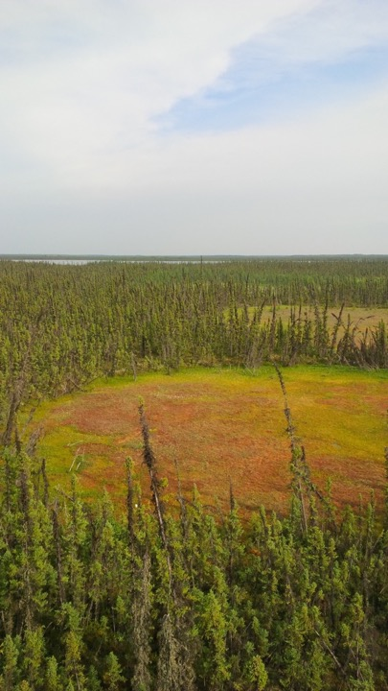
Study Site
Notes:
Discontinuous PF
3 landcover types

Slide 3
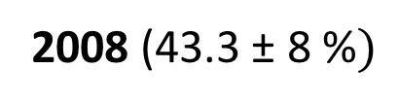
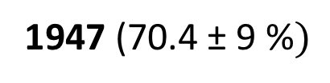
Permafrost Thaw
1947 (70.4 ± 9 %$)$
2008 (43.3 ± 8 %$)$
Permafrost
Permafrost - Free
Lake
Quinton, W. L., Hayashi, M., & Chasmer, L. E. (2011)

Slide 4
Hydrological Impacts of Ground Ice
Infiltration impedance
Moisture migration
Winter quiescence
Soil destabilization
Gray et al. 2001; Harlan 1973; Stähli et al. 1999; Woo 2012; Nelson et al. 2001
Notes:
Permafrost or seasonal ground ice

Slide 5
Existing Models of Ground Ice
Model Type | Pros | Cons | Example
Continuum | Non-equilibrium Multiple fonts | Numerically expensive Saturated (usually) Unstable | SUTRA-ICE Mcclymont et al.; (2013) McKenzie et al. (2007)
Front-tracking | Relatively efficient | Steady-forcing Single front Saturated | Stefan solution; Hayashi et al. (2007)

Slide 6
Objective
Develop a
Computationally efficient
Semi-analytical
Non-equilibrium
Variably-saturated
Multi-layered
Stable
model to describe
Seasonal frost
Active layer
Permafrost

Slide 7
Outline
Model description
Benchmarking
Stefan
Mass Balance
Unsaturated
Model Efficiency Comparison
Application
Observed thaw rates

Slide 8
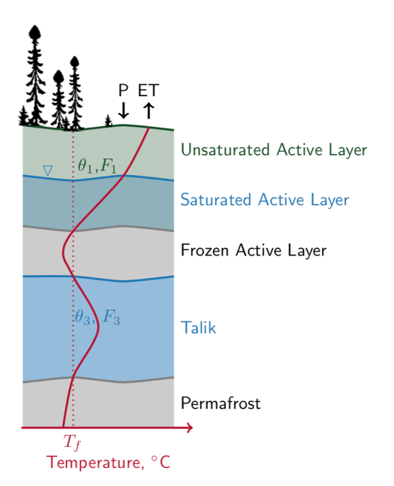
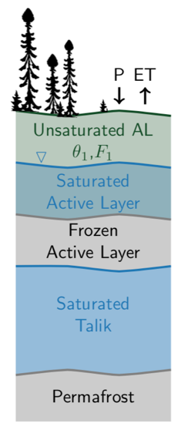
Interface Model
Dynamic domain elements defined by soil properties
Interfaces move based on mass and energy transfer
Simple mass balance
Temperatures profile determined by superposition of analytic solutions

Slide 9
The proof is in the numbers!
Water balance (equilibrium)
Freeze-thaw front
* Flux dependent on saturation and ice content

Slide 10
The proof is in the numbers!
Free boundary problem – Saturated
Free boundary problem – Unsaturated
Confined layer – Saturated

Slide 11
Outline
Model description
Benchmarking
Stefan
Saturated
Unsaturated
Model Efficiency Comparison
Application
Observed thaw rates

Slide 12
Stefan Problem Benchmark
0.5 cm error, 100 days
1.0 cm error, 1000 days
Notes:
Properties of water
IC : Uniform 0˚C
BC: Constant 5˚C

Slide 13
Saturated Model Benchmark
Frozen
Depth below ground [m]
Thawed
Slushy
Frozen
Time [days]
Notes:
FONT SIZE
Animate appearance of T in left
Flip xy left
Darkem T in left
Label zones in right plot

Slide 14
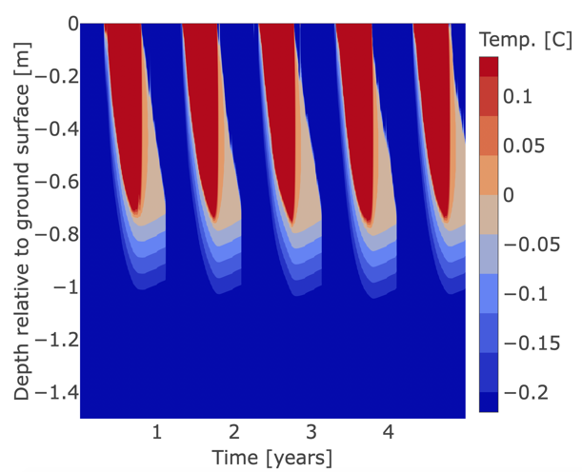
Unsaturated Model Benchmark

Slide 15
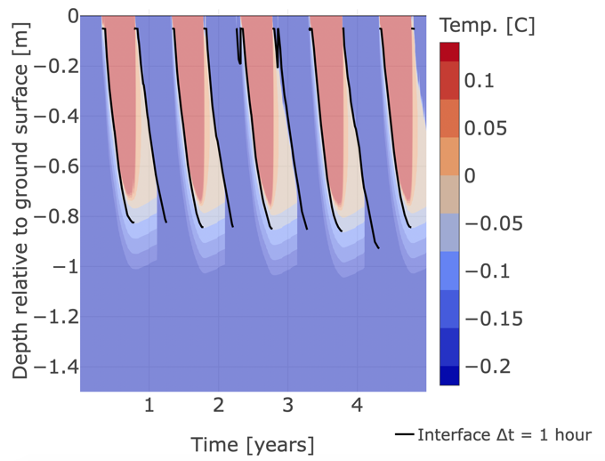
Unsaturated Model Benchmark

Slide 16

Unsaturated Model Benchmark

Slide 17
Outline
Model description
Benchmarking
Stefan
Mass Balance
Unsaturated
Model Efficiency Comparison
Application
Observed thaw rates

Slide 18
Model Efficiency Comparison
Unsaturated
Model Type | Finite Volume | Interface | Interface
Timestep | 1 h | 1 h | 24 h
Run time | 1275 s (21 min) | 63 s (1 min) | 4 s
5 year simulation
Notes:
% year simulaton
Note 24h stability difference

Slide 19
Outline
Model description
Benchmarking
Stefan
Mass Balance
Unsaturated
Model Efficiency Comparison
Application
Observed thaw rates

Slide 20
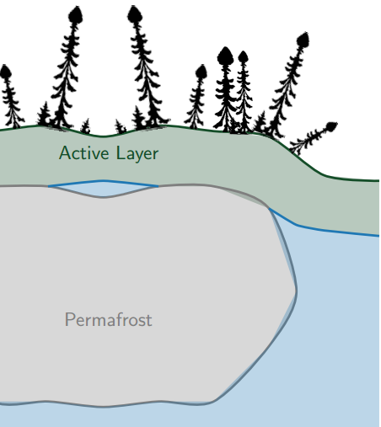
Application: Permafrost Degradation Rates
10 000 surface temperature series sampled from SARIMA models
PERMAFROST
TALIK
Initial talik thickness sampled from uniform distribution
Notes:
Font size

Slide 21
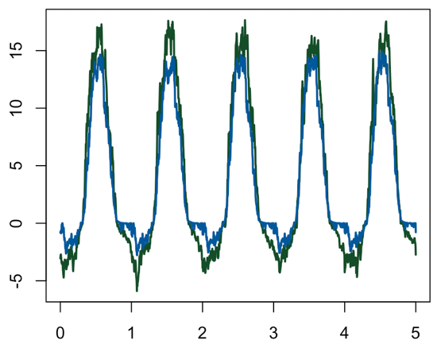
Temperature Boundary Conditions
Temperature [C]
TALIK
PERMAFROST
Time [years]
Notes:
Font size

Slide 22
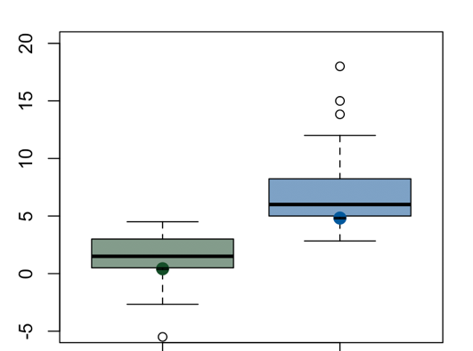

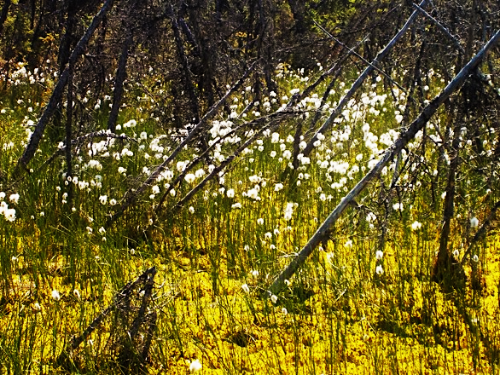
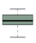
Permafrost Degradation: Field Data
Modelled
Measured
Change in
Depth to Permafrost [cm]
No
Talik
Talik
Connon et al. 2017
Notes:
This plot belings in the garbage

Slide 23
Conclusion
The interface model presented is
Fast!
Variably-saturated
Unconditionally Stable
Allowing for:
Uncertainty analysis
Sensitivity analysis
Stochastic simulations
Extended simulation duration
Next Steps
Test in other environments
Seasonal frost
Frost heave
Incorporation into hydrologic models
23

Slide 24


Acknowledgements
Many thanks to those who contributed to fieldwork and advised model development: Caren Ackley, Erfan Amiri, Dr. Nandita Basu, Michael Braverman, Genevieve Brown, Dr. Ryan Connon, Dr. James Craig, Dirk Friesen, Gabriel Hould Gosselin, Sarah Grass, Dr. Julie Mai, Dr. Jonathan Price, Dr. William Quinton, Lindsay Stone, and others.

Slide 25

Permafrost Degradation: Positive Feedback
Modelled
Talik formation
Measured
Change in
Depth to Permafrost [cm]
Increased radiation
Subsidence and ponding
Advection
Canopy degradation and
Increased conductivity
No
Talik
Talik
Connon et al. 2018
Connon et al. 2017

Slide 26
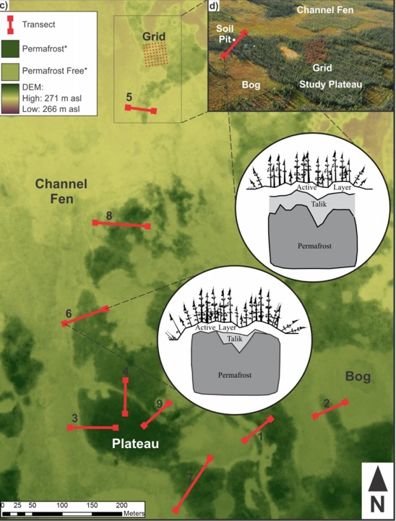
Permafrost disequilibrium
Measurements with talik (supra-permafrost layer > 80 cm)
 | Transect | Grid
2011 | 20% | 8%
2015 | 48% | 33%
Connon et al. 2018
Connon et al. 2017

Slide 27
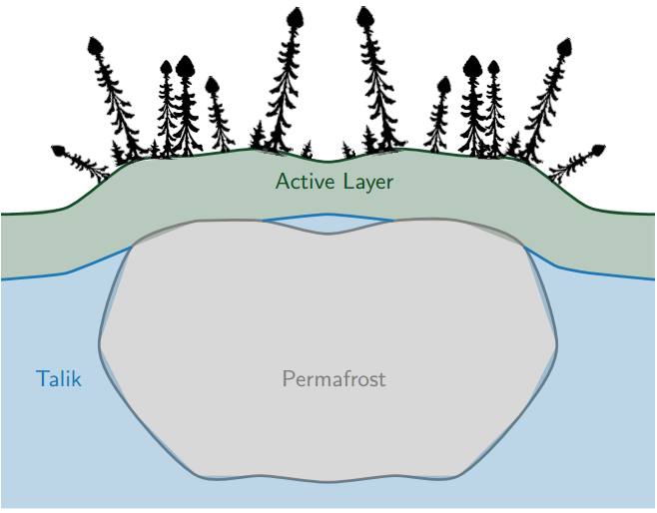
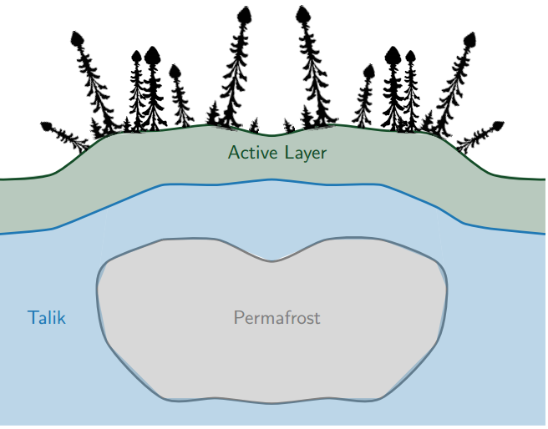
Taliks
Wetland
Connected
Confined
Isolated
Confined
Open
Notes:
Ground that is frozen for two or more consecutive years
Talik – confined, trhough, isolated, connected
Active Layer
Frost Table
Permafrost Table

Slide 28
Taliks
Wetland
Connected
Confined
Isolated
Confined
Notes:
Ground that is frozen for two or more consecutive years
Talik – confined, trhough, isolated, connected
Active Layer
Frost Table
Permafrost Table

